Slide 1



“FABRICATION AND ANALYSIS OF REINFORCED COMPOSITES”
Submitted
in Partial Fulfilment of the Requirements for the degree
of
BACHELOR OF TECHNOLOGY
in
Mechanical Engineering
Submitted by
ABU TALHA (1900540400004)
HABIB ULLAH BALTI (1900540400022)
NITESH SINGH (1900540400029)
SANDEEP KASHYAP (1900540400036)
Under the Guidance of
Dr. Ankit Asthana
(Asst. Prof. Dept of Mech. Engg.)

Slide 2
CONTENTS
Introduction of Reinforced Polymer Composites
Materials Used
Fabrication Method
Working Models
Analysis Techniques
Advantages of Reinforced Polymer Composites
Disadvantages of Reinforced Polymer Composites
Applications of reinforced polymer composites
Benefits to Society and Environment
Future Scope
Conclusion
Some Pictures While Working

Slide 3
INTRODUCTION TO REINFORCED POLYMER MATRIX COMPOSITES
Composite material is defined as the material formed by combining two or more different materials/ constituents macroscopically that are distinct in the properties, and they do not dissolve into each other. Materials are combined in such a way as to enable us to make better use of them virtues while minimizing g to some extent the effects of their deficiencies. We have worked on the Polymer Matrix Composite (PMC). To make the composite material we have used coir and Portland pozzolana as a reinforced material .It is a composite material which is made of various continuous and the short fibers attached together with the matrix. They are made to distribute the loads between the fibers and the matrix. The main advantage of polymer matrix composite is they are light weight, high resistance, corrosion free.

Slide 4
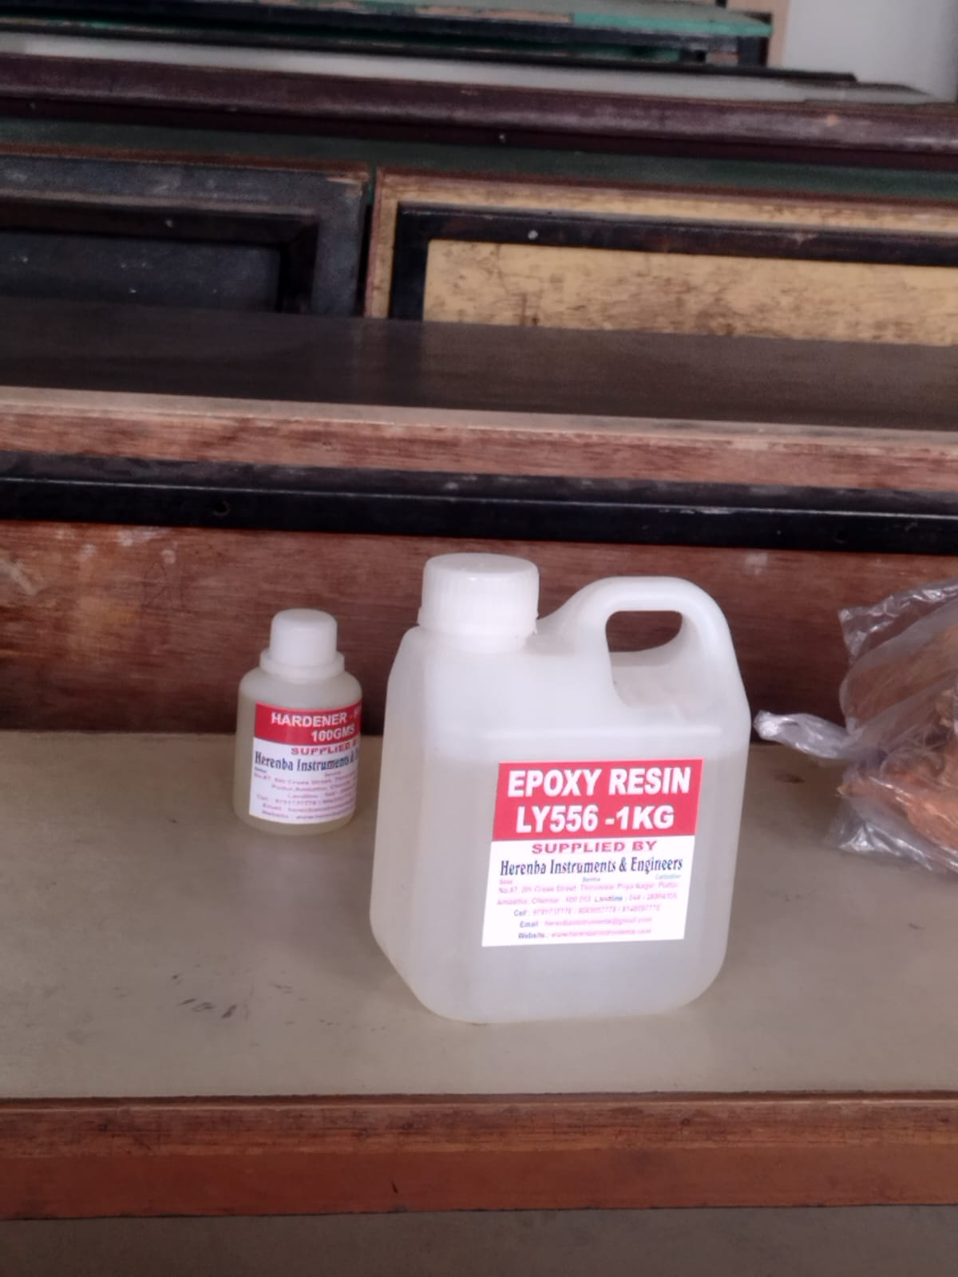
MATERIALS USED
1. Epoxy Resin(LY-556)
Epoxy resin has many industrial applications for a variety. It is a higher mechanical properties and thermal and chemical resistance. The Epoxy resin LY/556 is used for formation a composite material. The Epoxy resin LY556 is used as a reinforcing material due to its medium viscosity and chemicals resistivity. It is low cost it has been very well documented in the literature for hundred years that the incorporation of nanofiller to polymer glasses and semi crystalline polymer can remarkably improve the performance of polymer.
Fig.1 Epoxy resin

Slide 5
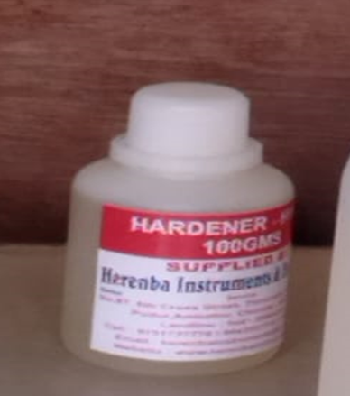
2 .Hardener(HY-951)
A hardener is a component which is used with epoxy resin to achieve the result. In other words, we use the mixing hardener +epoxy resin to increase resilience of the mixture once it set hardener is work like as a catalyst in the chemical reaction that occurs during the mixing process. A Hardener also known as an accelerator. It is most important to make an epoxy resin to useful for its purpose.
Fig. 2 Hardener

Slide 6
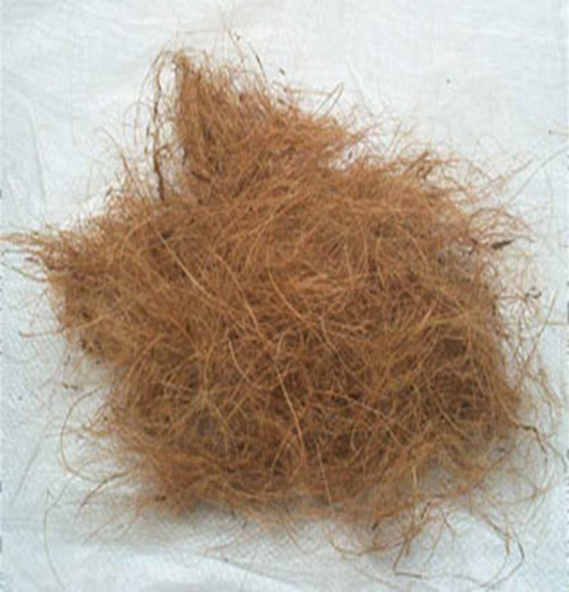
3. Coir (coconut husk)
Coir is multilateral natural fibre extracted from mesocarp or husk of the coconut fruit generally fibre is of golden colour when cleaned after removing from coconut husk it is also known as golden fibre this is the natural fibre and it is part of the coconut shell. The fibre protects the fruit enough to survive months floating on ocean it is grow on the tree of coconut.
Fig.3 Coir(Coconut Husk)

Slide 7
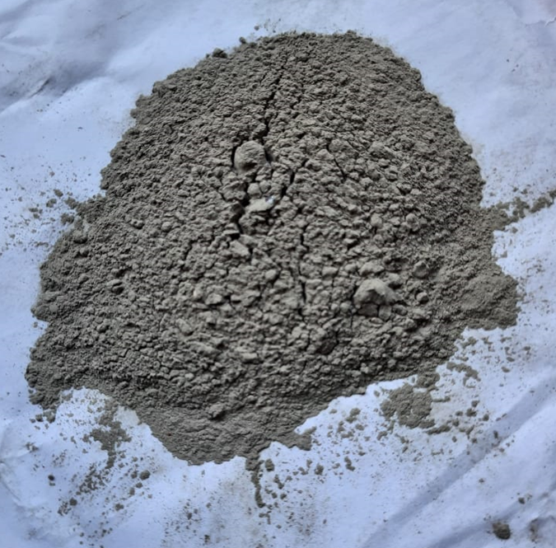
4. Portland Pozzolana
Portland is an ash or eruptive powder. It is natural eco-friendly material. The Portland Pozzolana is found in near Italy. The material can be natural or synthetic which contain silica and aluminous in a reactive form. The material generally doesn't possess any cementing properties, however when it is mixed with water or lime to undergo reaction with calcium hydroxide to form compounds possessing cement properties.
Fig.4 Portland pozzolana

Slide 8
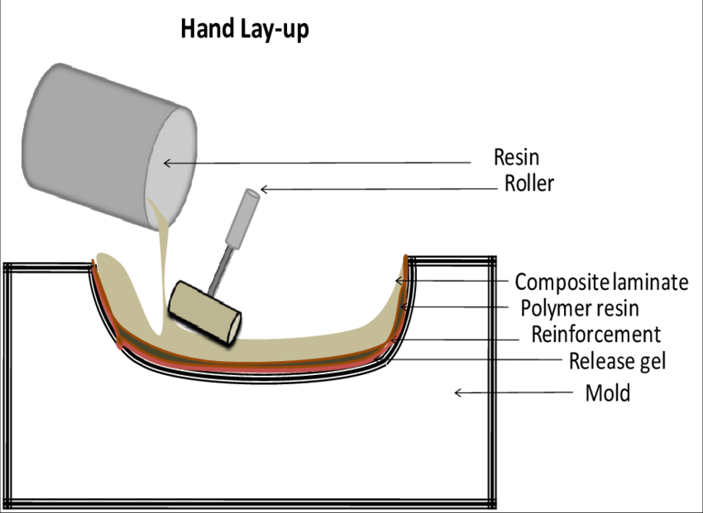
FABRICATION METHODS
Hand Layup
Hand layup is a traditional and widely used fabrication method for reinforced polymer composites.
Involves manually placing reinforcement materials in a mold and applying the liquid polymer resin.
The steps involved in this method are:
Preparing the Mould
Material Preparation
Applying the Resin
Placing the Reinforcing Fibers
Consolidation
Curing
Demoulding and Finishing
Fig.5 Hand lay-up method

Slide 9
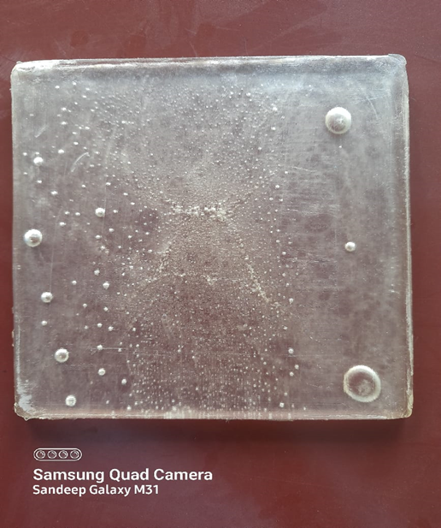
WORKING MODELS
1. PRIMARY COMPOSITE PLATE
This is a primary composite made by using epoxy resin (LY554/6) and hardener (HY951) taken in ratio of 10:1 as 150ml epoxy resin and 15ml hardener. Mixing epoxy resin and hardener begins with a chemical reaction that transforms the combined liquid ingredients into a solid. The period of transformation is cure time which is 48 to 72 hours.
Fig.6 primary composite plate

Slide 10
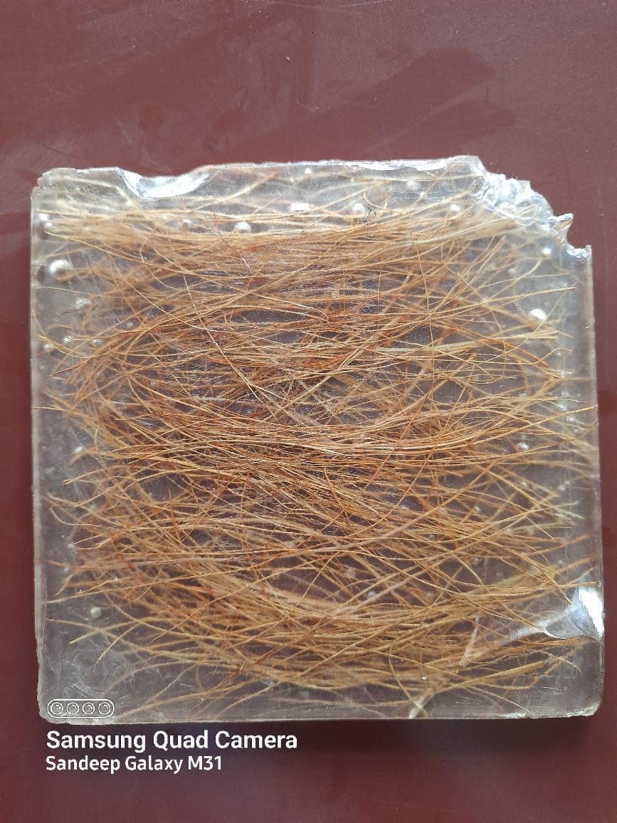
2. COIR COMPOSITE
This is a coir composite in which we used coir (coconut husk) as the reinforcement material.in this composite 30% of coir and rest is epoxy resin. The dimension of this composite plate is 150mm*150mm.
Fig.7 Coir Composite

Slide 11
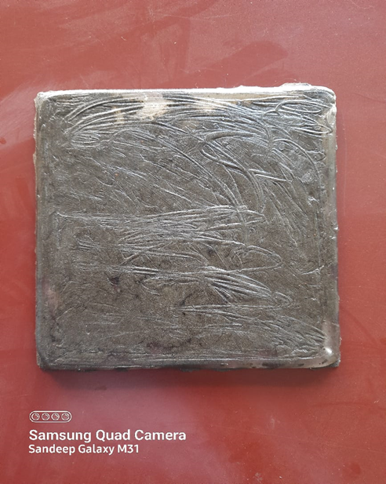
3. PORTLAND POZZOLANA COMPOSITE
This is a composite in which we have used Portland pozzolana (black cement) as the reinforcement. In this composite there is 30% of Portland pozzolana and rest is epoxy resin. The dimensions of this composite is 150mm*150mm
Fig.8 Portland Pozzolana Composite

Slide 12
ANALYSIS TECHNIQUES
Mechanical Testing
Mechanical testing is performed to evaluate the performance of reinforced polymer composites.
flexural testing and impact testing are conducted to determine properties such as strength, stiffness, and toughness

Slide 13
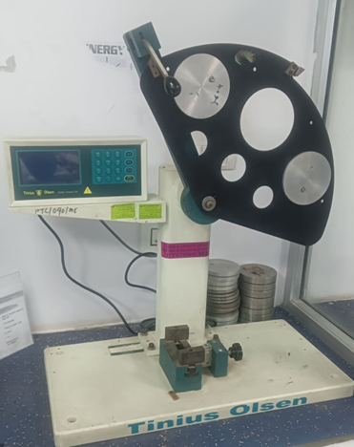
IMPACT TEST
IMPACT TEST
The fracture toughness of an engineering material is a very significant property. Composite materials, when they fail, tend to fail in a disastrous way. Unlike metals they suddenly fail with little yielding before totally collapsing. So, it is very important to have a minimum impact force needed to induce a crack into the composite material. Impact test determines the amount of energy absorbed by a material during fracture. This absorbed energy is a measure of a given material's toughness and acts as a tool to study temperature-dependent brittle-ductile transition. It is to determine whether the material is brittle or ductile in nature. All the samples were cut according to the ASTM- D256.
Fig.9 Impact Testing Machine

Slide 14
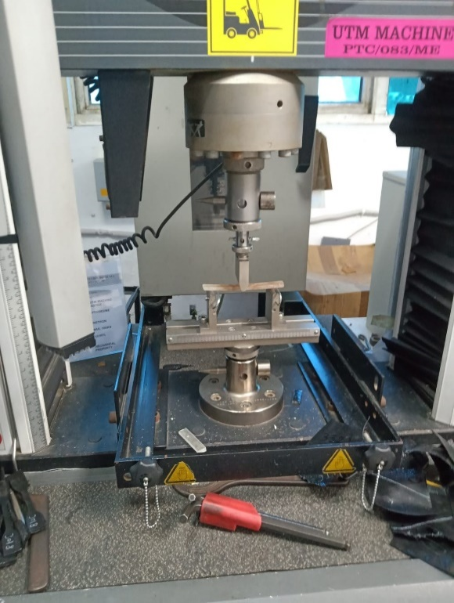
FLEXURAL TEST
Engineers often want to understand various aspects of material's behaviours, but a simple uniaxial tension or compression test may not provide all necessary information. As the specimen bends or flexes, it is subjected to a complex combination of forces including tension, compression, and shear. For this reason, bend testing is commonly used to evaluate the reaction of materials to realistic loading situations. Flexural strength can be measured using two tests namely 3-point bend test and 4-point bend test. For our study, we will be using 3-Point Bend Test. All the samples were cut according to the ASTM 790D .
Fig. 10 Flexural Testing Machine

Slide 15
TESTING RESULTS
1. Flexural Strength
During flexural (3-point bend) test, specimens were mounted on the UTM machine with clams and holders for flexural tests. Tension was applied to the test specimen until it fractured on the testing machine. The deflection of the specimen was measured using the crosshead position. Deformation and flexural strength were also assessed We get to know that the flexural strength of coir composite is more than the other two composites i.e., 88.01MPa. The coir fibre contains cellulose, hemi cellulose and lignin (the fibre contains 30 to 300 or more cells in its total cross-section) and its cross-section is polygonal or round

Slide 16
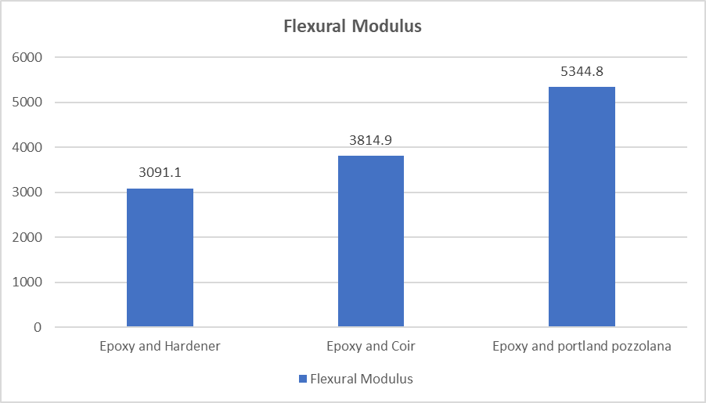
2.Flexural Modulus
Flexural modulus is a convenient measure of composite stiffness. Fillers can contribute significantly to a stiffness increase. The flexural modulus (sometimes referred to as the bending modulus or tangent modulus) of a material is a mechanical property. It describes its stiffness or resistance to a bending action or its ability to deform in bending. It was observed that the flexural modulus of coir and Portland pozzolana composites is higher than primary epoxy composite (sample 1). it indicates that Coir (sample 2) and Portland Pozzolana (sample 3) composites have higher tendency to bend when a given amount of bending stress is applied.

Slide 17
3. Impact Strength
The Impact Strength Test were performed on the CEAST Torino, model RDNL, at CIPET, Lucknow. Specimen dimensions prepared and method were used according to ASTM D256. During testing, the specimen was loaded into a device and the pendulum was allowed to swing until it broke. Impact tests were used to measure the energy necessary to break the material, and this energy was used to determine the toughness and yield strength of the material.
we have got that the impact strength of coir composite (sample 2) is higher than the other two composites. The impact strength of Coir Composite is found to be 3.28kj/m² which is the highest among the three samples.

Slide 18
ADVANTAGES OF REINFORCED POLYMER COMPOSITES
Lightweight: Reinforced polymer composites are known for their low density, making them ideal for applications that require weight reduction.
High Strength: The addition of reinforcement materials enhances the strength and stiffness of the composites, enabling them to withstand greater loads.
Corrosion Resistance: Polymer matrices are inherently resistant to corrosion, making reinforced composites suitable for harsh environments.
Design Flexibility: Composites can be molded into complex shapes, allowing for design freedom and customization.

Slide 19
DISADVANTAGES OF REINFORCED POLYMER COMPOSITES
Cost: Reinforced polymer composites can be expensive compared to traditional materials such as steel or aluminum.
Fabrication of Polymer matrix Composites by Hand lay-up Method is too laborious and at low production rate
Recycling Challenges: The recycling of reinforced polymer composites can be challenging due to the complex nature of the material and the difficulty in separating the polymer matrix from the reinforcement materials.
Moisture Absorption: Polymer matrices are prone to moisture absorption, which can lead to dimensional changes, reduced mechanical properties, and degradation over time.

Slide 20
APPLICATIONS OF REINFORCED POLYMER COMPOSITES
Space: antenna, radar, satellite structures, solar reflectors, etc.
Aircraft: aerofoil surfaces, compressor blades, engine bay doors, fan blades, rotor shafts in helicopters, turbine blades, turbine shafts, wing box structures, etc.
Automobiles: automobile body, bumper, mudguards, door panels, dashboard, driveshaft, fuel tank, CNG cylinder, chassis, fender, etc.
Wind turbine blades: rotor blades, nose cone, nacelle cover, accessories for wind electric generators.
Sports: Skis, surfboards, windsurfing, table tennis boards, slats, and gliding wing spar, Tennis, badminton, fishing rods, golf clubs, baseball bats, hockey sticks, pole shaft, Sword, etc.

Slide 21
BENEFITS TO ENVIRONMENT AND SOCIETY
Light weight and high strength
Lower cost
Low maintenance cost
Sustainable and recyclable
Improved efficiency
Design Flexibility

Slide 22
FUTURE SCOPE
Enhancing mechanical properties
Improving water resistance
Investigating alternative processing methods
Investigating new raw materials
Developing new processing technique
Improving durability

Slide 23
CONCLUSION
Coir/epoxy resin and Portland Pozzolana/epoxy resin, based composites were fabricated by hand lay-up method by mixing 30% coir and 30% Portland Pozzolana as a reinforcement, we found that the coir, which is a natural reinforcement has higher mechanical properties than synthetic reinforcement like Portland Pozzolana which resulted in higher flexural and impact strength of coir composite. The value obtained from the test of flexural strength is 88.01 MPa, and the impact strength value is 3.28KJ/m² of the coir composite. Coir/epoxy may perform better than Portland Pozzolana when choosing a material having high flexural and impact strengths, compared to Portland pozzolana composites coir composite would make an effective reinforcement for creating composites. The desire for bio composites in various applications due to the need for green composites in automobile, packaging, electronics, health, and structural industries has further increased the interest of researchers in the use of bio fibres. Composite materials are used extensively in the automobile, aerospace, and wind energy industries. industries include electrical, sports, household use, civil construction, pharmaceuticals, and chemicals, etc. Composite materials have a wide range of possible uses in structures that are predominantly exposed to compression loads.

Slide 24
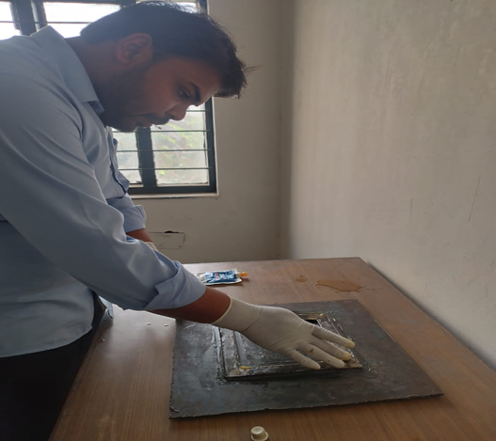
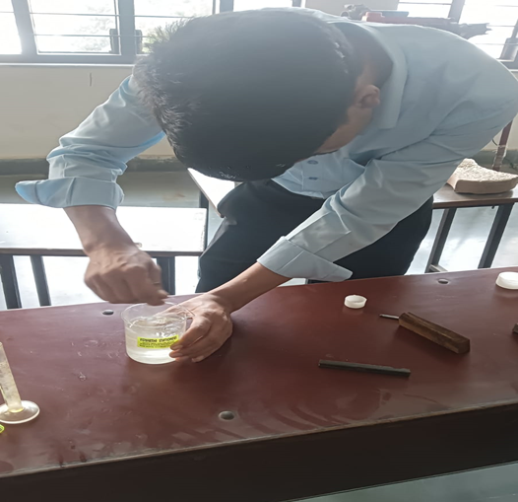
SOME PICTURES WHILE WORKING ON PROJECT
Figure.11 : Applying grease on the mould
Figure.12: Mixing epoxy and hardener

Slide 25
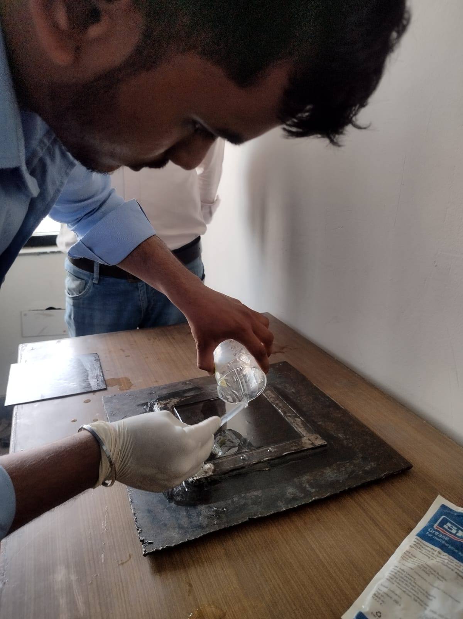
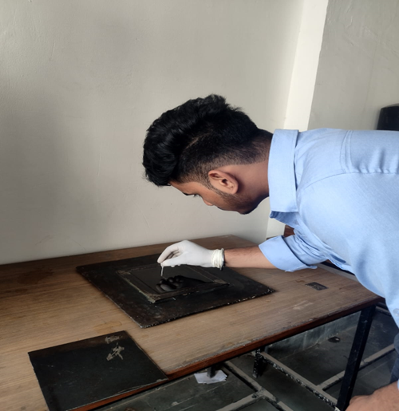
SOME PICTURES WHILE WORKING ON PROJECT
Figure 13: Pouring of solution on mould
Figure 14: Removing bubbles

Slide 26
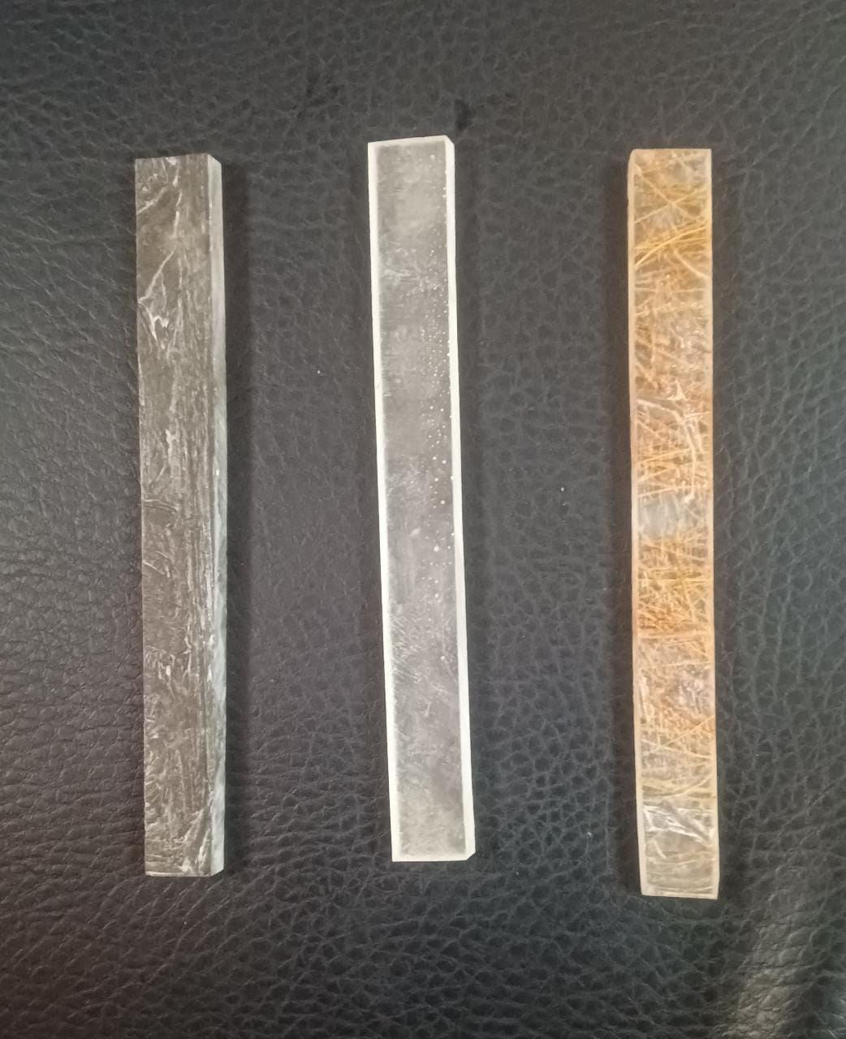
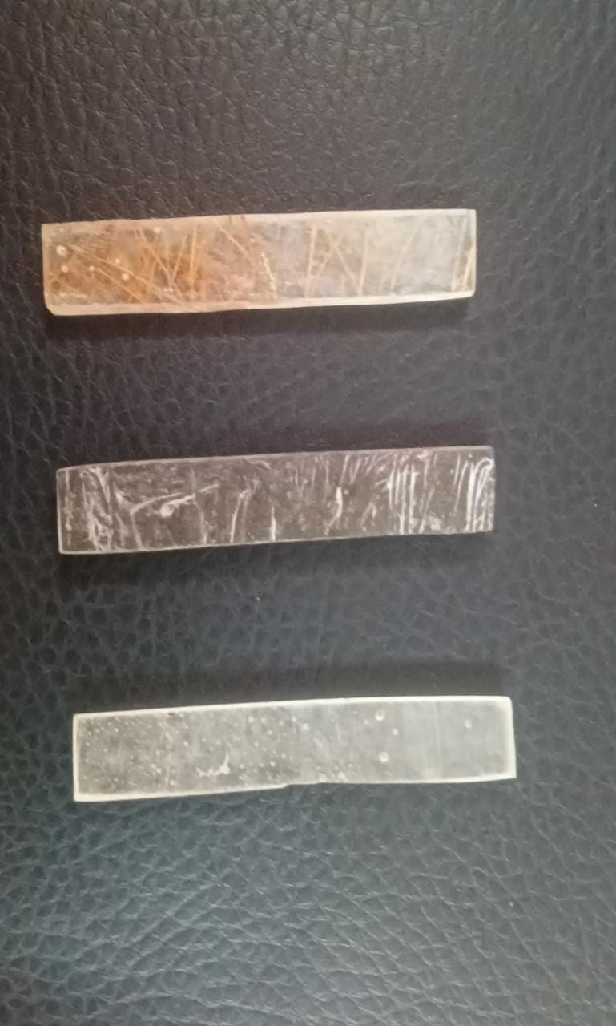
SPECIMENS FOR TESTING
Fig. 16 Specimen For Flexural Test
Fig.17 Specimen For Impact Test

Slide 27
THANK YOU

